Slide 1
Jesús Rojo González
NCP Marie Sklodowska-Curie Actions
UAB, 24 Mayo 2016
Individual Fellowships
2016 Call

Slide 2
Index
Some results

Slide 3
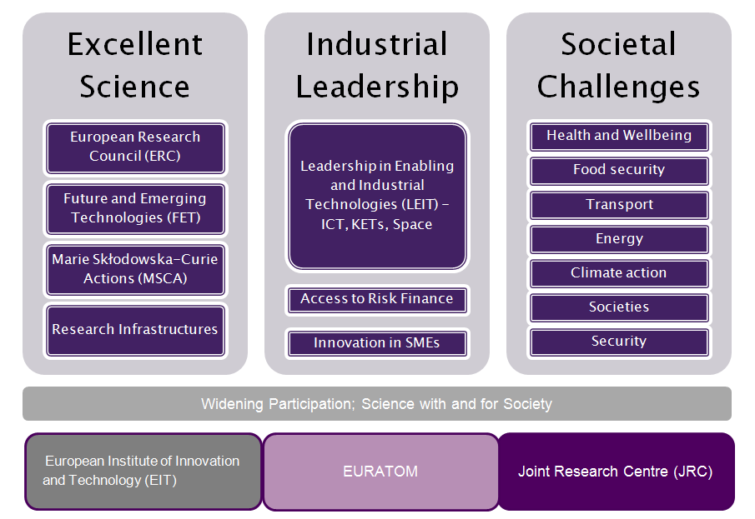
MSCA in HORIZON 2020
3

Slide 4
Horizon 2020 – Excellent Science
ERC | 13.094,81 €
FET | 2.695,99 €
MSCA | 6.162,26 €
Infrastructures | 2.488,01 €
TOTAL | 24.441,07 €
MSCA 2016 Calls Budget: 759.07 M€
MSCA 2017 Calls Budget: 841.31 M€
4

Slide 5
Results for Spain – MSCA Calls 2014/2015*
Data: CDTI, 26/01/16
* Preliminary data 2015
2014:
2nd country in RISE
3rd country in attracting research talent IF
11 ITN coordinated
2015:
12 ITN coordinated
Funding: 96,55 M€

Slide 6
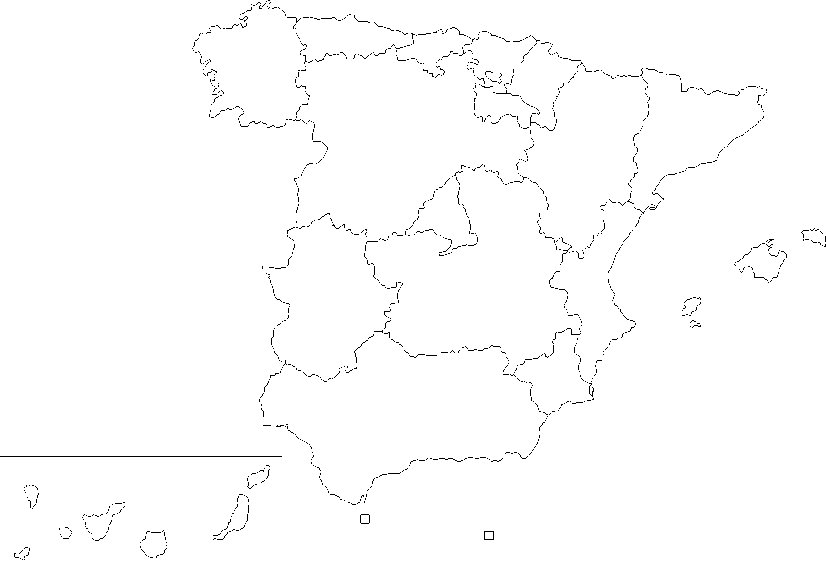




MSCA Events 2014/2015: events and workshops
WEBINARS
2014
2015
2014
+ 30 promotional events / trainings throughout 11 Autonomous Regions in Spains
+ 2.050 participants attended the sessions + online impact (webstreaming, youtube channel)
2015
+ 40 promotional events / trainings throughout 11 Autonomous Regions in Spain,
+ 2,000 participants attended the sessions + online impact (webstreaming, youtube channel)
Notes:
En 2014 se realizaron 33 sesiones informativas / talleres, este año 2015 la cifra no solo se mantiene, sino que se incrementa ligeramente (+35). Todo ello es posible gracias a la implicación no solo de la NCP de la OE sino también del NCP de la Fundación para el conocimiento Madri+d, Jesús Rojo, ambos forman un gran equipo -☺
Se intenta llegar al mayor número posible de CCAA y se cuenta con la colaboración de las agencias de innovación regionales (o similar) para asegurarse que estas actividades tienen el mayor impacto posible (+ 2,000 asistentes al finalizar el año).
Por otra parte, se intenta tbién utilizar herramientas on-line para llegar a un mayor número de participantes, como ha sido el caso en la difusión de la convocatoria IF 2015 para las Comunidades CERU/CERFA/ECUSA.

Slide 7
MSCA questions answered and pre-screening
2014
2015
Proposals from ITN 2015 pre-screened in 2014
ITN 2016 started in Oct 15 – Jan.16.: 25
Notes:
2014: Management FP7: 10%
2015: 62% IF + 21% IF . FP7 on going: 4%

Slide 8
MSCA Objectives
  Ensure the optimum development and dynamic use of Europe´s intellectual capital in order to generate new skills, knowledge and information
Support of the researchers´career path at all stages
Mobility is a key requirement: triple “i” dimension
Adquisition of new and complementary skills
Strong industry participation
Excellent working conditions, gender balance and open recruitment
Communication and public engagement activities
Bottom-up approach
CHE Chemistry | SOC Social Sciences and Humanities | ECO Economic Sciences | ENG Information Science and Engineering | ENV Environmental and Geosciences | LIF Life Sciences | MAT Mathematics | PHY Physics
8

Slide 9
Novelties WP2016/2017
Strong Continuity respecting with WP2014/2015 approach
Slight modifications in the evaluation criteria to avoid overlap
New transversal concept Responsible Research and Innovation (RRI)
Gender aspects explicitly indicated under the Excellence award criterion
Further involvement of the non-academic sector in IF – new Society and Enterprise Panel
Template B divided in 2 documents
2016 budget of MSCA comparable to 2015 level (759 million EUR)
2017 budget: 10.5% increase, 841 million EUR

Slide 10

MSCA IF: objectives
  Enhance the creative and innovative potential of experienced researchers by providing them with opportunities to acquire new knowledge, work on research projects in a European context or outside Europe
  Special eligibility conditions for those resuming a career, returning to Europe and opportunities in non-academic sector
A personal fellowship to support a period of mobility
  For Experienced Researchers
      Post-PhD or equivalent
    No upper age or experience limit
Fully-funded fellowships: Salary, research costs etc.
Academic or non-academic host
CRITERIA TO BE TAKEN INTO CONSIDERATION
Mobility rule (specific for CAR and RI)
Full –time research experience: experienced researchers
Nationality (especific for RI and GF)
10

Slide 11



MSCA IF: 2 options 5 opportunities
European Fellowships
Standard Panel
Reintegration Panel
Career Restart Panel
Society and Enterprise Panel
For fellows coming to or moving within Europe
For fellows from Europe going to Third countries and returning
Global Fellowships
(1)
(2)

Slide 12

Important concepts
Is a researcher eligible?
  Research Experience
  Mobility rule
  Nationality (some IF Panels)
How can the institutions participate?
  Beneficiaries
  Partner organisations
Who can participate?
  Sectors: academic and non-academic
  Country participation

Slide 13



Research experience
EXPERIENCED RESEARCHERS (ER)
IF finance researchers that are in possession of a doctoral degree or have at least 4 years of full-time equivalent research experience.
To be fulfilled at the deadline for the submission of proposals: 14/09/2016
Full time equivalent research (FT): is measured from the date when a researcher obtained the degree which would formally entitle him / her to embark on a doctorate, etiher in the country in which the degree was obtained or in the country in which the reesarcher is recruited.
13

Slide 14

Mobility Rule I
Standard European Fellowship (EF)
For researchers coming to or moving within Europe
No more than 12 months in the 3 years before the call deadline in the country of the host organisation
Reintegration Panel (RI)
For those who wish to (or recently have) relocated to Europe from outside
Must be nationals or previous long-term residents (> 5 years) of a European country
Relaxed Mobility Rule: no more than 3 years in the 5 years before the call deadline in the country of the host organisation

Slide 15
Mobility Rule II
Career Restart Panel (CAR)
For researchers coming to or moving within Europe
For people who have taken a career break (any reason) for at least 12 months before call deadline
Relaxed Mobility Rule: no more than 3 years in the 5 years before the call deadline in the country of the host organization
Society and Enterprise (SE)
For researchers coming to or moving within Europe
Relaxed Mobility Rule: no more than 3 years in the 5 years before the call deadline in the country of the host organization

Slide 16
Mobility Rule III
Global Fellowship (GF)
For researchers moving to a Third Country and compulsory return phase to Europe
Must be nationals or previous long-term residents (> 5 years) of a European country
No more than 12 months in the 3 years before the call deadline in the country of the host organisation (Outgoing Phase)

Slide 17
Sectors - IF 2015
ACADEMIC SECTOR
public or private High Education Institutions (HEI) awarding academic degrees
NON –ACADEMIC SECTOR
any other socio-economic actor not included in the academic sector definition (i.e: SMEs, enterprises, NGOs, hospitals, government bodies, museums…)
public or private non-profit research organisations
International European interest organisations(IEIOs) http://eiroforum.org/

Slide 18
Participating institutions - IF 2015
BENEFICIARY
Host institution: hosts, recruits, trains the ER, located in a Member State (MS) or Associated Country (AC)
PARTNER ORGANISATION
Does no recruit the ER (doesn´t sign the GA), offers additional training and hosts the researcher during his / her secondment.
Receives funding from EC.
Signs the Grant Agreement with the EC.
Outgoing phase of the Global Fellowships
Secondments in European Fellowships
Letter of Commitment (Global Fellowship only): indicating activities of the project, updated…
Partner Organisation:

Slide 19

Country Participation - IF 2015
Member States (MS): 28 countries (including overseas countries)
Associated Countries (AC) to H2020 (Iceland, Norway, Albania, Bosnia and Herzegovina, Former Yugoslav Republic of Macedonia, Israel, Moldova, Montenegro, Serbia, Turkey, Switzerland)
Third Countries (TP): No MS, No AC
 | Beneficiary | Partner Organisations
European Fellowships | Compulsory: MS / AC | Optional: MS / AC
Global Fellowships | Compulsory: MS / AC | Compulsory: TC Optional: MS / AC

Slide 20

Application/Contractual Process
Joint preparation: between the fellow (ER) and the Host Institution (supervisor: mentor the ER during his / her recruitment period – EC Contact Person)
A researcher (ER) can only submit one proposal to one implementation mode.
Bottom-up: 8 scientific panels + 3 Multidisciplinary Panels (CAR + RI + SE).

Slide 21
How it works
European Fellowships
Researcher applies with European host
Host signs contract with EC
Host employs researcher
Researcher applies with European host
European host signs contract with EC
European Host employs researcher
Global Fellowships
Supported by non-European host
Non-European host signs agreement with European host
Researcher seconded to non-European host

Slide 22

European Fellowships – EF ST
STANDARD EUROPEAN FELLOWSHIP
Experience Researcher of any nationality must move or have moved from any country to the MS or AC where the host institution is located
Mobility rule: not have resided or carried out his / her main activitiy in the country of the host institution for more than 12 months / 3 years prior to the call deadline
Duration of the project: 12 - 24 months (secondments included)
8 Scientific Panels
22

Slide 23

European Fellowships – EF CAR
CAREER RESTART PANEL (CAR)
Support to researchers who want to resume research in Europe after a break in research
ER of any nationality who must move or have moved from any country to the MS / AC where the host institution is located
Break in research: not active in research for at least 12 months prior to the deadline of submission (14/09/2016)
Multidisciplinary Panel
Duration of the project: 12-24 months
Specific mobility rule CAR: no more than 36 months out of the 5 years previous to the Call deadlne
23

Slide 24

European Fellowships – EF RI
REINTEGRATION PANEL (RI)
Support to researchers who want to return and reintegrate in a longer term research position in Europe
Mobility from a Third Country to a MS / AC where the host institution is located
ER eligible: nationals or long-term residents of a MS / AC (min. 5 consecutive years carrying out research in 1 or more MS / AC)
Multidisciplinary Panel
Duration of the project: 12-24 months
Specific mobility rule RI: no more than 36 months out of the 5 years previous to the Call deadlne
24

Slide 25
Society and Enterprise Panel - Main Features
New in 2016
Multidisciplinary panel in EF
Dedicated budget - EUR 10 million
Open to organisations from the non-academic sector: Industry (incl. SMEs), hospitals, charities, NGOs, government/public bodies, national archives, libraries, etc
Research and innovation-related projects can be funded
Relaxed mobility rule to apply (like in CAR and RI)
~ 70-80 fellowships available
Option of secondment to academic sector
12 – 24 months’ duration

Slide 26
Global Fellowships IF - GF
Duration: 12-24 months, outgoing phase in a TC + 12 months returning phase in Europe.
ER elegible: nationals and long-term residents in MS / AC
Mobility from any country to the TC of the outgoing phase
Mobility rule to be fulfilled in the TC of the outoing phase
Minimum participation: 1 beneficiary in MS / AC (host institution) + 1 Partner Organisation in TC
Letter of Commitment from Partner Organisation in TC compulsory
26

Slide 27
MSCA IF: secondments
During the IF, can be seconded to any host organisation in Europe
Ideally should take place in a different sector, i.e. academic to nonacademic or vice-versa
Have to take place in a Partner Organisation in a MS / AC
Meaningful and appropriate to the type of fellowship and research field
Partner Organisations: no need to include a letter of commitment
The secondment can be split into several shorter periods
If you can’t specify the precise host organisation for the secondment in the proposal, must at least specify the sector (academic or nonacademic), the timing and the purpose of the secondment
IF Duration | Duration max. secondment
≤ 18 months | 3 months
> 18 months | 6 months

Slide 28

MSCA IF RESULTS 2014-2015

Slide 29
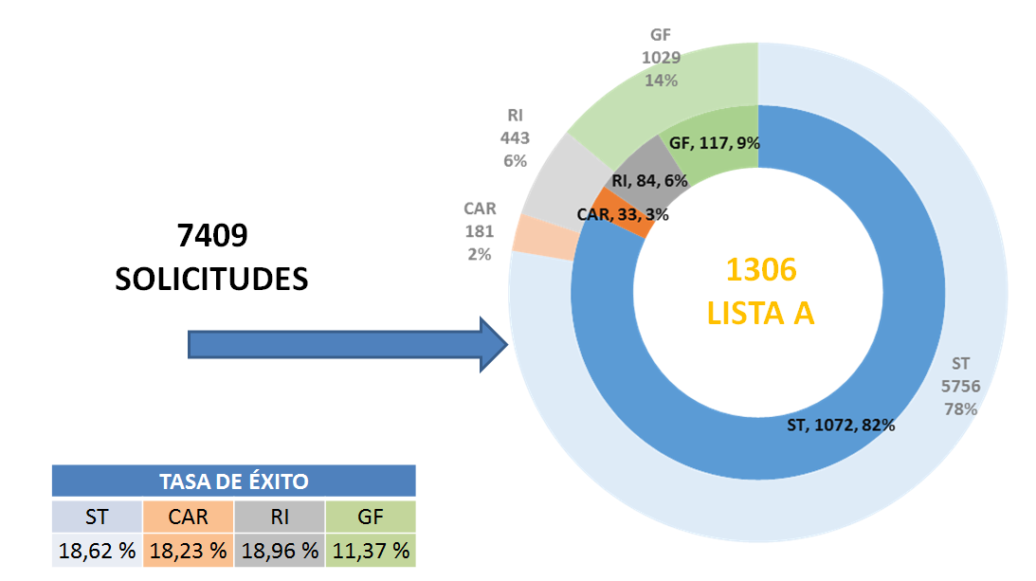
IF 2014: Submitted & A-list proposals
29

Slide 30
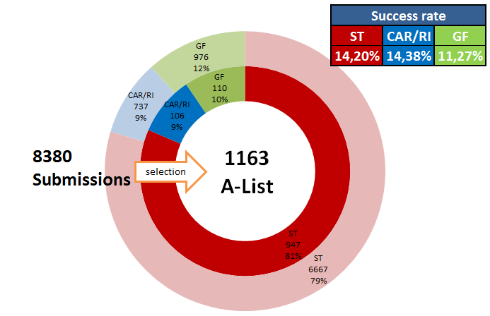
IF 2015: Submitted & A-list proposals

Slide 31
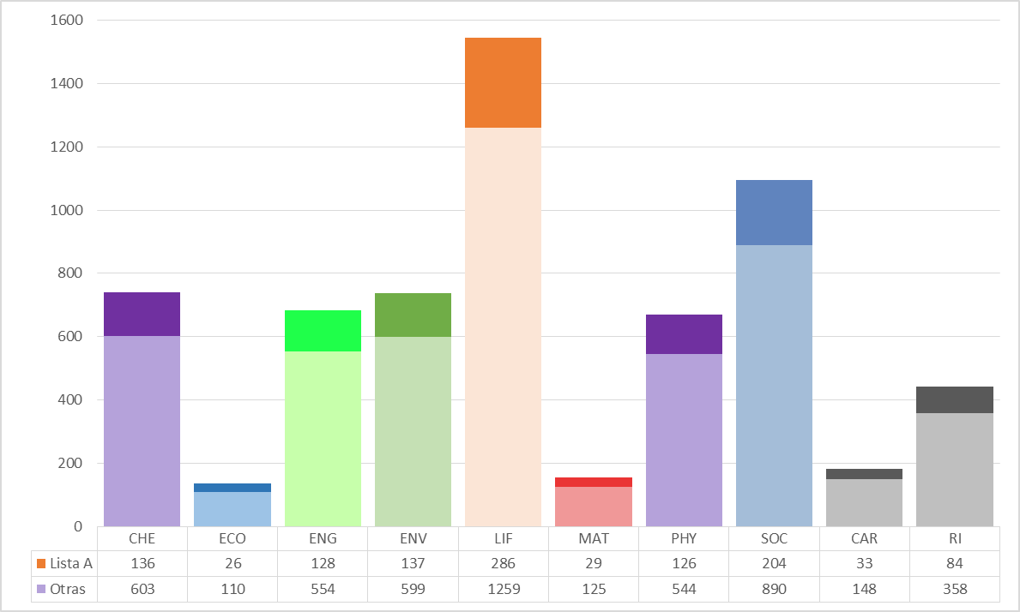
IF-EF 2014: Eligible and A-list proposals by panel
31

Slide 32
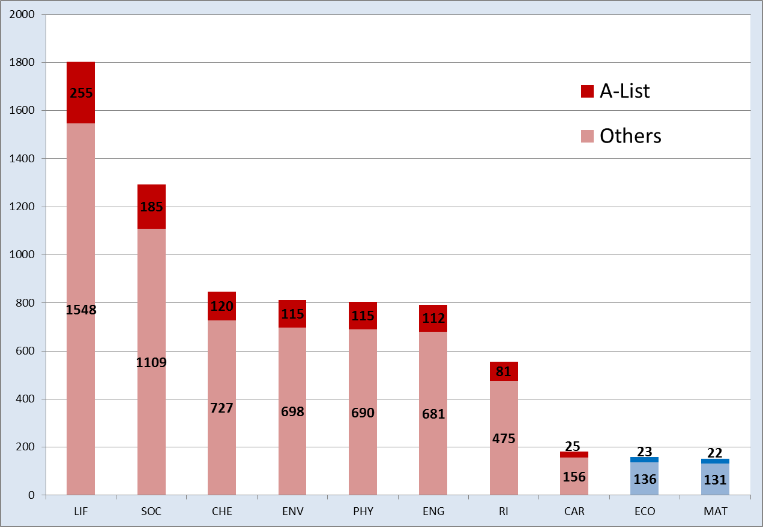
IF-EF 2015: Eligible and A-list proposals by panel

Slide 33
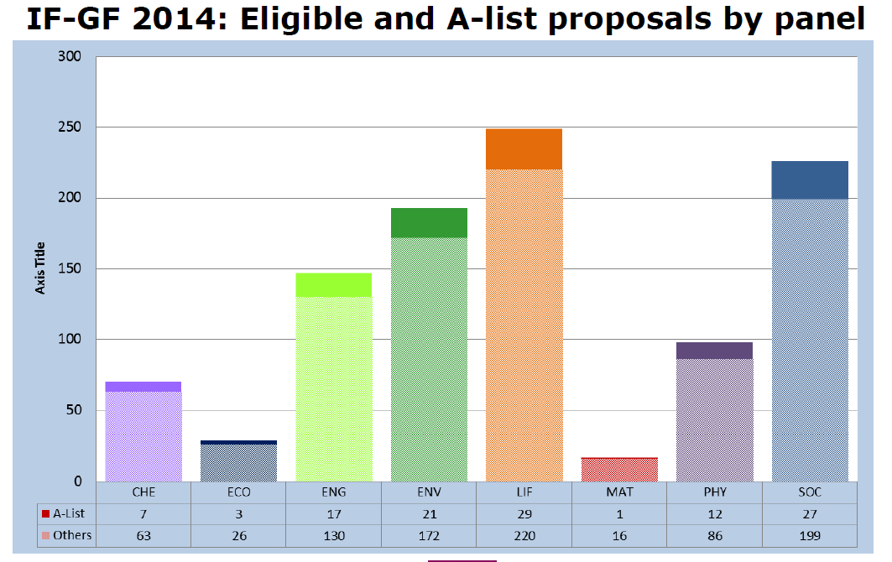
IF-GF 2014: Eligible and A-list proposals by panel
33

Slide 34
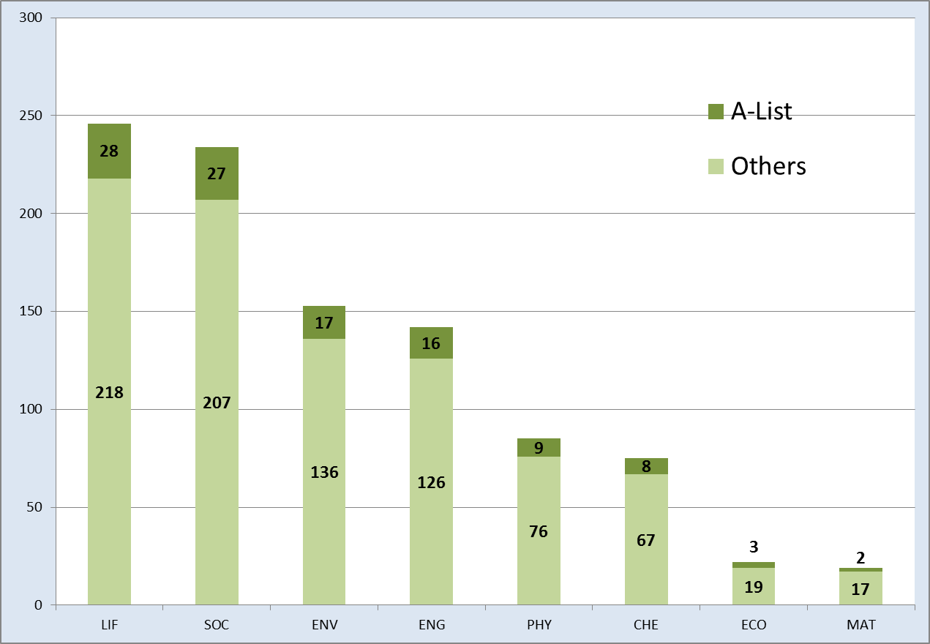
IF-GF 2015: Eligible and A-list proposals by panel

Slide 35
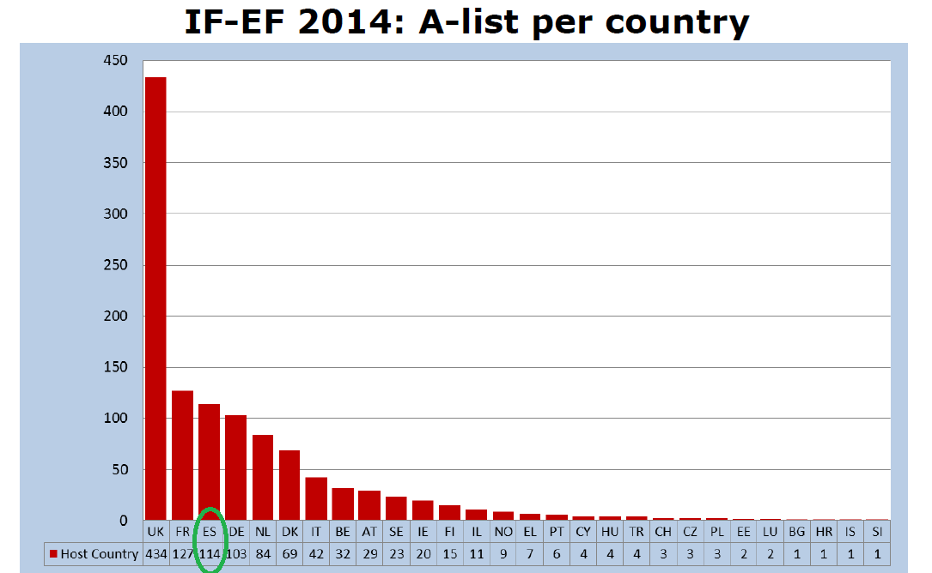
IF-EF 2014: A-list per country

Slide 36
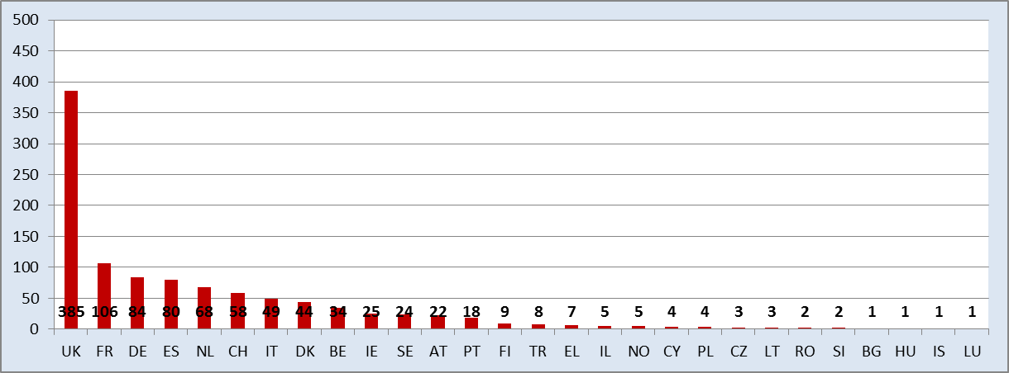
IF-EF 2015: A-list per country

Slide 37
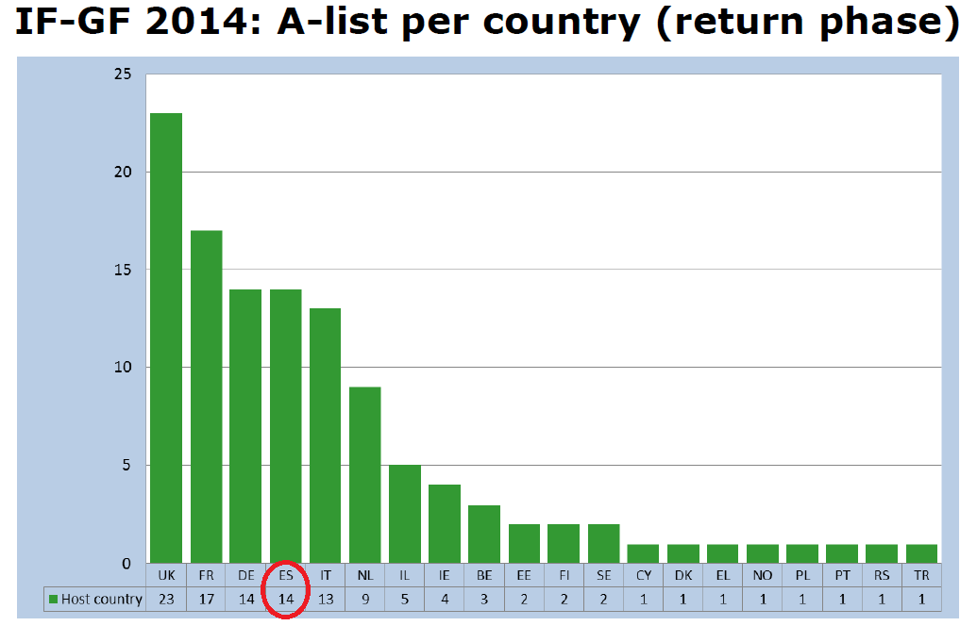
IF-GF 2014: A-list per country

Slide 38
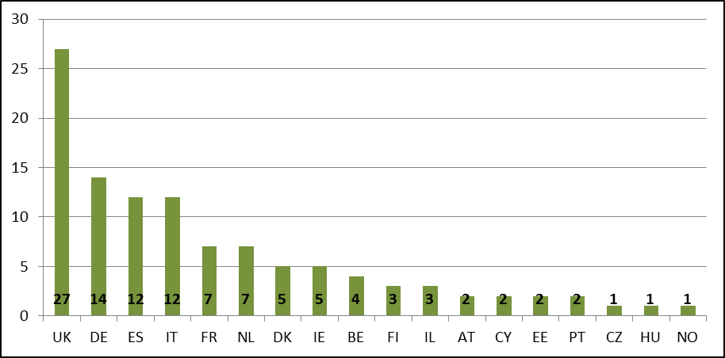
IF-GF 2015: A-list per country

Slide 39
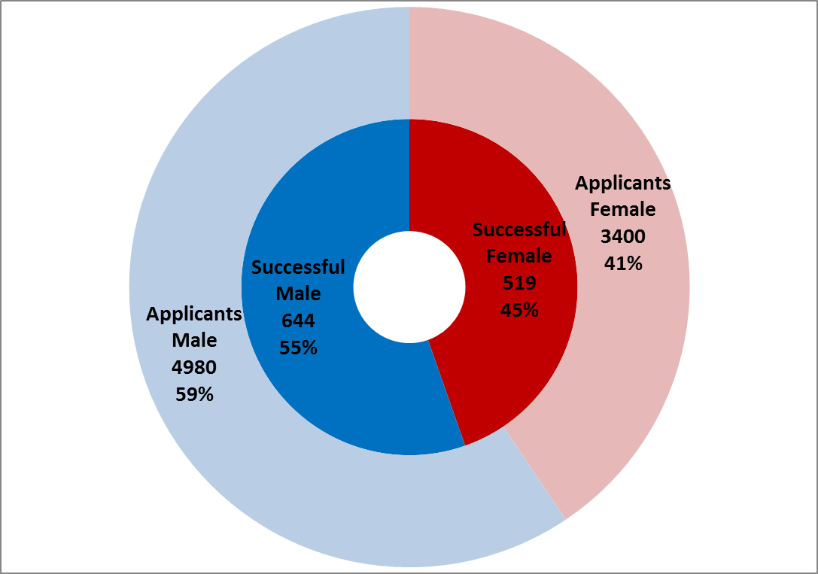
Gender of researchers

Slide 40
Cut off marks EF ST – CAR - RI 2014-2015
Chemistry (CHE) 89,6
Physics (PHY) 90,4
Mathematics (MAT) 90,2
Life Sciences (LIF) 90,6
Economic Sciences (ECO) 86,6
ICT and Engineering (ENG) 88,6
SSciences & Humanities (SOC) 92,8
Earth & Environmental Sc (ENV) 90,4
CAR 87,2
RI 90,8
CHE 90,8
PHY 91,2
MAT 91
LIF 92,4
ECO 89,8
ENG 90,8
SOC 92,2
ENV 92,2
CAR 91,2
RI 92,2

Slide 41
Cut off marks GF 2014-2015
Chemistry (CHE) 93,6
Physics (PHY) 93
Mathematics (MAT) 92,2
Life Sciences (LIF) 91,8
Economic Sciences (ECO) 92,4
ICT and Engineering (ENG) 93,8
SSciences & Humanities (SOC) 92,8
Earth & Environmental Sc (ENV) 93,4
CHE 94
PHY 93,4
MAT 91,6
LIF 93,8
ECO 94
ENG 93,8
SOC 93,6
ENV 93,6

Slide 42
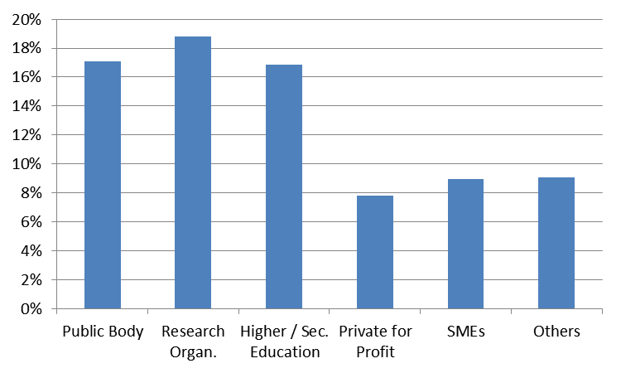
Society and Enterprise Panel - Rationale
Average success rate: 16.8%
Only 2.7% of IF 2014 beneficiaries were from the non-academic sector
0.4% of IF 2014 beneficiaries were SMEs
IF 2014 success rates by sector

Slide 43
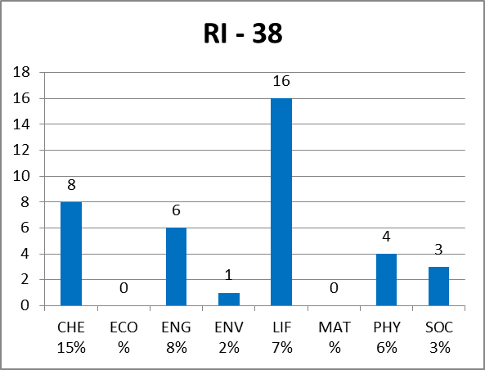
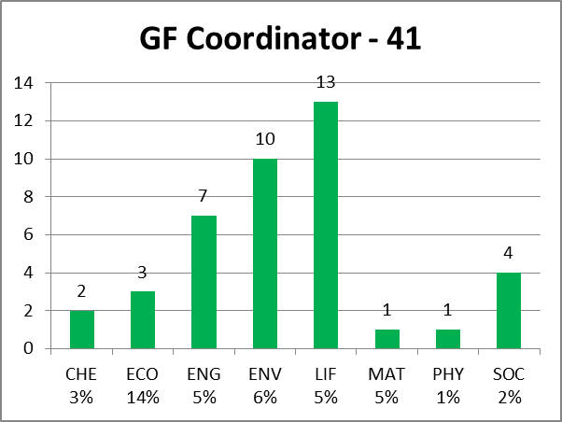
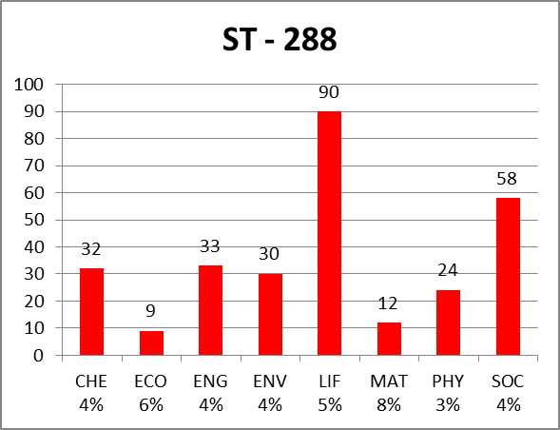
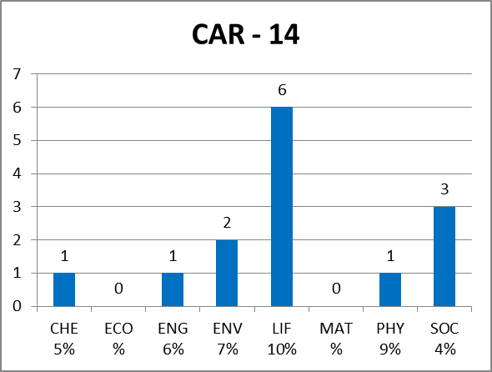
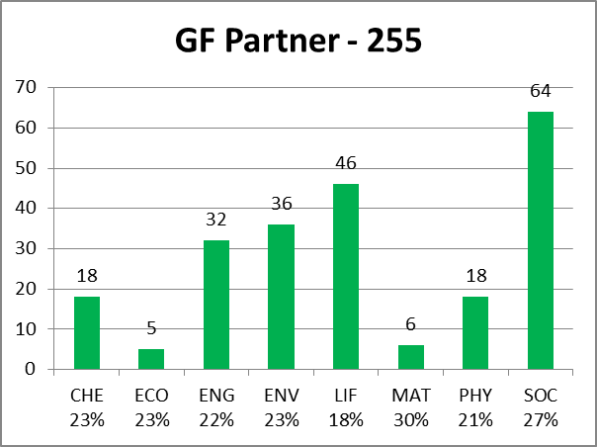
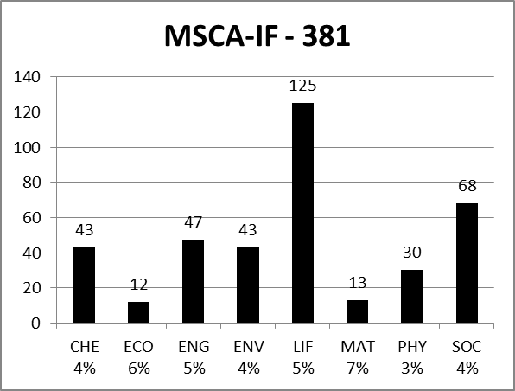
IF 2015: non-Academic submissions

Slide 46
Overview of the Individual Fellowships

Slide 47
Timing MSCA – IF 2016
Call IF 2016
Call ID | Opens | Closes | Budget
H2020-MSCA-IF-2016 | 12-APRIL-2016 | 14-SEPTEMBER-2016 | EF: 179.5 M€ SE: 10 M€ GF: 27 M€
Expected Schedule 2020-MSCA-IF-2016
Publication of the Call: 12 april 2016
Closing of the Call: 14 september 2016
Evaluation of the proposals: october – november 2016
Results of the evaluation: February 2017
Signing of the Grant Agreements: May 2017
47

Slide 48
Funding Model MSCA IF 2016
MSCA | Researcher Unit Cost (person/month) |  |  | Institutional Unit Cost (person/month)
 | Living Allowance * | Mobility Allowance | Family Allowance | Research, training and networking | Management and overheads
IF | 4.650 | 600 | 500 | 800 | 650
Fellow’s Salary = Living Allowance + Mobility Allowance (+ Family Allowance)
Rates in table are inclusive of employers’ costs (e.g. Cuota patronal, Seguridad Social, IRPF, etc)
A country coefficient applies to the Living Allowance (e.g. 97,6 for Spain, 120,3for UK)
Estimated Gross Salary (prior to employee’s tax, social security, etc) €55.000
Family Allowance: determined at the submission deadline
48

Slide 49
MSCA IF 2015: Evaluation criteria
PART B
DOCUMENT 1
Evaluation Criteria
Threshold: 70%
No individual thresholds
Excellence
Impact
Implementation
Page limit: 10
No limit per section
Criteria | Weight | Priority (ex.aequo)
Excellence | 50% | 1
Impact | 30% | 2
Implementation | 20% | 3
DOCUMENT 2
4. CV of the experienced researcher
5. Capacities of the participating organisations
6. Ethical aspects
7. Letters of Commitment of Partner Organisations (GF)
49

Slide 50
More than just a research project; a career development fellowship
Training through research (individual project)
Additional scientific skills (new techniques, instruments etc.)
Transferable skills (e.g. communication, IPR, entrepreneurship etc.)
Interdisciplinary/inter-sectoral transfer of knowledge (secondments)
Can spend up to 6 months (in total) working in another organisation (ideally in another sector) in Europe.
Opportunity to link with industry, NGO, public sector, national archive etc.
Research and financial management of the fellowship
Organising and taking part in events (including public engagement)
Training in gender and ethics issues
Must be managed by a Career Development Plan

Slide 51
Evaluation Criteria
51

Slide 52
Excellence
EXCELLENCE
Quality and credibility of the research/innovation project; level of novelty, appropriate consideration of inter/multidisciplinary and gender aspects
Quality and appropriateness of the training and of the two way transfer of knowledge between the researcher and the host
Quality of the supervision and of the integration in the team/institution
Capacity of the researcher to reach or re-enforce a position of professional maturity/independence
Estado del Arte bien planteado, objetivos claros, metodología excelente
Originalidad y aspectos innovadores: avances en el campo científico
Doble transferencia de conocimiento, Caso GF: no hay que olvidar el retorno a Europa
Experiencia supervisor (publicaciones, visibilidad internacional...)
Integración ER en la institución (carrera investigadora…)
Investigación puntera, Plan de formación que permitirá reforzar la posición profesional / madurez del investigador
52

Slide 53
Excellence
1.1. Quality and credibility of the research/innovation project; level of novelty, appropriate consideration of inter/multidisciplinary and gender aspects
Evaluators will assess:
State of the art, objectives and overview of the action
Research methodology and approach
The type of research and innovation activities proposed
Originality and innovative aspects of the research programme
Gender aspects
Objective: to assess how the high-quality, novel research is most likely to open up the best career possibilities for the Researchers and new collaboration opportunities for the host organization.

Slide 54


What does gender dimension mean?
Integrating the gender dimension in research content means taking into account
the biological characteristics of both females and males (sex) and
the evolving social and cultural features of women and men, girls and boys (gender)

Slide 55
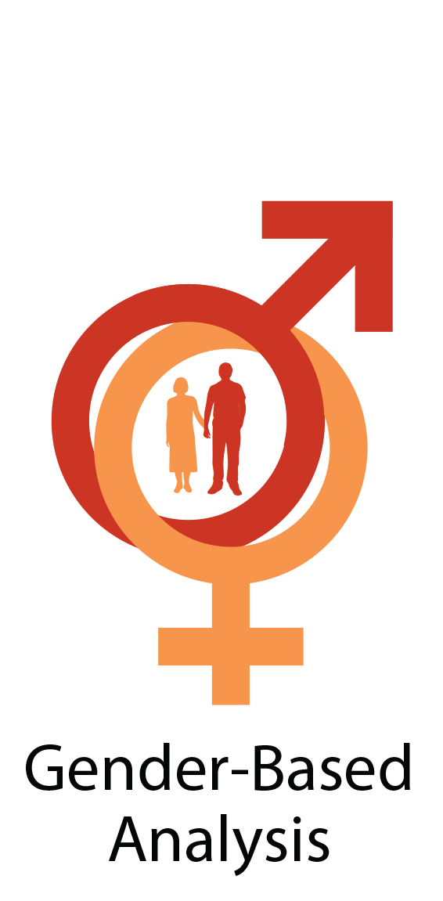
Why is it important to take the gender dimension into account?
Integrating the gender dimension in R&I
  leads to an in-depth understanding of citizens’ needs, behaviours and attitudes,
  is an added value in terms of excellence and innovation
Thus, it enhances the societal relevance of the knowledge, technologies and innovations produced and contributes to the production of goods and services better suited to potential markets.

Slide 56

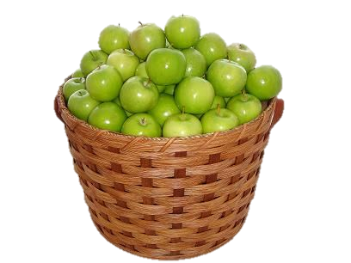




Why is it important to take the gender dimension into account?
Being blind to potential differences of sex and gender may result in missed opportunities, with certain groups of people being left out, poorly accommodated etc.
Hello…?
Designing to stereotypes may result in unpopular products.

Slide 57



Further information on the gender dimension in R&I content
For further information, you can consult the website of Gendered Innovations, a peer-reviewed project supported by the European Commission: http://ec.europa.eu/research/gendered-innovations/
On this website, you can also find a short videos on various aspects of "Gendered Innovations: Harnessing the Creative Power of Gender Analysis for Discovery and Design"
(http://genderedinnovations.stanford.edu/video_landing.html )
http://genderedinnovations.stanford.edu

Slide 58
Excellence
1.2. Quality and appropriateness of the training and of the two way transfer of knowledge between the researcher and the host
Evaluators will assess:
The two way transfer of knowledge between the researcher and the host institution, in view of their future development and past experience:
  How the researcher will gain new knowledge from the hosting organization during the fellowship training
  Transfer from the researcher to the host organization of the knowledge ad skill previously acquired.
For Global Fellowships: how the new skills and knowledge acquired in the Third Country will be transferred back to the host institution in Europe.

Slide 59
Excellence
1.3 Quality of the supervision and of the integration in the team/institution
Evaluators will assess:
The qualification and experience of the supervisor(s):
  The level of experience of the supervision on the research topic proposed;
  Track record of work, including the main international collaboration.
  Participation in project, publication, patens and any other relevant results.
The hosting arrangements; the integration of the researcher to his/her new environment in the premises of the Host. This is not about the infrastructure.
The Career Development Plan should not be included in the proposal but at least a brief description.

Slide 60
The VITAE Researcher Development Framework ©
https://www.vitae.ac.uk/researchers-professional-development/about-the-vitae-researcher-development-framework

Slide 61
Excellence
1.4 Capacity of the researcher to reach or re-enforce a position of professional maturity/independence
Evaluators will assess:
How can the proposed research and personal experience contribute to the professional development as an independent/mature researcher
They will check your Curriculum Vitae and will evaluate the track record in relation of research experience

Slide 62
Impact
IMPACT
Enhancing the potential and future career prospects of the researcher
Quality of the proposed measures to exploit and disseminate the project results
Quality of the proposed measures to communicate the project activities to different target audiences
Impacto mejora conocimiento del ER / institución de acogida.
Beneficios a nivel EU
Contribuir a perspectivas de Carrera a medio y largo plazo.
Estrategia de diseminación de los resultados, publicación en Open Access
Protección de los resultados, IPR, estado de la Técnica, prever generación de patentes
Estrategia completa de acciones de comunicación y divulgaciónón hacia el publico general, compromiso púbico.
62

Slide 63
Impact
2.1 Enhancing the potential and future career prospects of the researcher
Evaluators will assess:
The expected impact of the research and training and new competences acquired during the fellowships on the capacity to increase prospects for the fellow after this fellowships finishes
To what extent competences acquires during the fellowship, including any secondments, increase the impact of the researchers’ future activity on European Society.
Involving stakeholders and end-users.

Slide 64
Impact
2.2 Quality of the proposed measures to exploit and disseminate the project results
Evaluators will assess:
Dissemination of the research results
  Dissemination of the research results should include papers, publications and participate in international conferences with high impact.
  Open Access
Exploitation of results and intellectual property rights
  A plan for protection of the results. Your TTO or EPO is key here.
  Highlight previous experience in patents
  Create a strategy for protection and exploitation
Must be included in the Gantt Chart

Slide 65
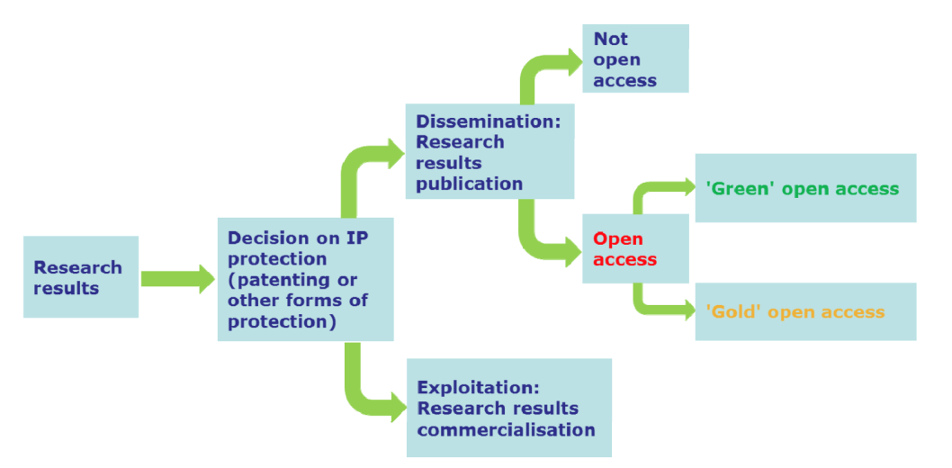
Open Access – Open Science H2020
Applicants and beneficiaries should respect the Horizon 2020 strategic priority of Open Science.
Open Science is an inclusive process aimed at promoting diversity in science across the European Union and opening it to the general public, in order to better address the H2020 societal challenges and ensure that science becomes more responsive both to socio-economic demands and to those of European citizens.
Open Science also provides significant new opportunities for researchers to disseminate, share, explore and collaborate with other researchers.
https://ec.europa.eu/programmes/horizon2020/en/h2020-section/open-science-open-access

Slide 66
Impact
2.3 Quality of the proposed measures to communicate the project activities to different target audiences
Evaluators will assess:
Communication and public engagement strategy of the action
    RRI (Responsible Research and Innovation)
    How the ER get feedback from citizens
    Real commitment from the Host Institution and from the fellow
    Highlight previous experiences in Host Institution
    Remark fellows’ profile on outreach, communication and public engagement
    Define properly Communication, Outreach and Public Engagement
    Must be included in the Gantt Chart

Slide 67
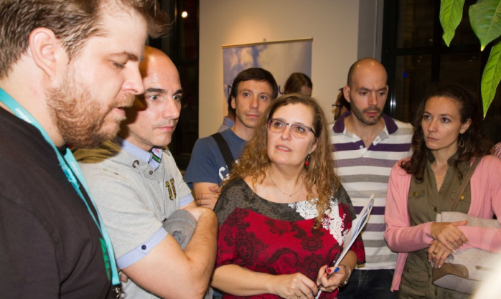
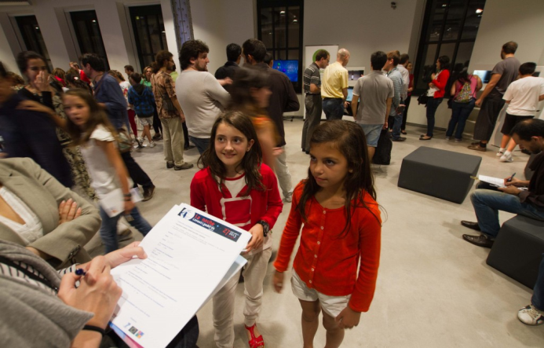
Outreach versus Communication
Outreach
Activities aimed at reaching a big audience (presentations at schools, seminars, visits to labs…)..
Objective: inform the general public of the benefits / results of the research carried out.
Language used has to be accesible to the public.
Outreach activities:
European Researchers' Night (NIGHT) // EU open days // // EXPO 2015 // Meet The Fellows
Marie Sklodowska-Curie Ambassadors // Facebook fellow of the week // Going to schools, science festivals, etc.
http://ec.europa.eu/research/mariecurieactions/documents/documentation/publications/outreach_activities_en.pdf

Slide 68
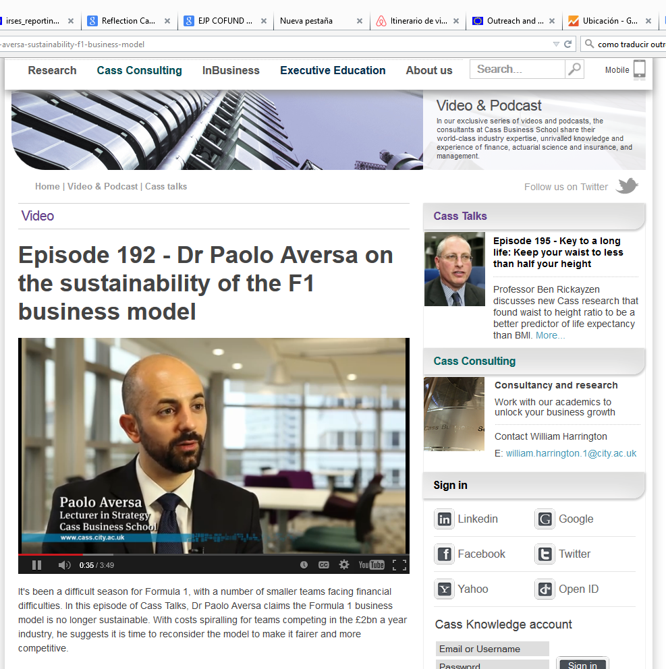
Communication versus Outreach
Communication activites refer to articles in newspapers, journals, TV and radio programmes.
Needs a clear language and an attractive scientific topic with results in order to attract the public interest.
Examples
http://internacional.elpais.com/internacional/2015/03/13/actualidad/1426257897_005821.html
http://www.irishtimes.com/news/health/fat-fighter-1.538013
Public talks (Paolo Aversa)

Slide 69





Five Dimesions of RRI
Science Education
Ethics
Gender Equality
Open Access
Engagement
The engagement of citizens and civil society in Research and Innovation;
The Gender equality and gender dimension in the Research content;
Formal and informal science education;
Ethics;
And a more open science, including the open access to scientific results.
Notes:
In practice Responsible research and Innovation is a package including 5 dimensions:
The engagement of citizens and civil society in Research and Innovation;
The Gender equality and gender dimension in the Research content;
Formal and informal science education;
Ethics;
And a more open science, including the open access to scientific results.
A Responsible Research and Innovation approach should contain all of these dimension without excluding any of them.
In the 5 slides to come, you will see how Responsible Research and Innovation has been integrated into Horizon 2020.

Slide 70

Ethical Aspects
All proposals will undergo an ethics review
Human Embryos / Foetuses
Humans
Human Cells / Tissues
Protection of Personal Data
Animals
Third Countries
Environmental Protection and safety
Dual Use
Misuse
Other Ethics Issues
Participants have to:
Identify all potential ethical aspects
Explain their future management
Give a detailed explanation at proposal stage
Description on Ethics:
Ethic Issues Table en part A
Ethics Self-Assessment en part B
RTD-ETHICS-REVIEW-HELPDESK@ec.europa.eu

Slide 71
Quality and efficiency of the implementation
IMPLEMENTATION
Coherence and effectiveness of the work plan
Appropriateness of the allocation of tasks and resources
Appropriateness of the management structure and procedures, including risk management
Appropriateness of the institutional environment (infrastructure)
WPs, tareas y recursos asignados
Deliverables / Milestones
Gantt Visual y comprensible
Estructura de gestión (mecanismo de seguimiento, apoyo RRHH – OPEs…)
Planes de contingencia (visual: tabla…)
Adecuación de las infraestructuras, acceso a recursos / instalaciones /
Complementariedad de instituciones con el proyecto / ER
71

Slide 72
Implementation
3.1 Coherence and effectiveness of the work plan
The proposal should be designed in order to achieve the desired impact, the evaluator will assess:
Work Packages description
List of major deliverables (= tangible output: report, document, technical diagram, software, etc.)
List of major milestones (=control/ decision points that help to chart progress)
Secondments
IMPORTANT: ASK FOR HELP TO YOUR TTO - EPO
The GANTT Chart should be clear and complete

Slide 73
Implementation
3.2 Appropriateness of the allocation of tasks and resources
The evaluator will assess:
Describe how the work planning and the resources mobilised will ensure that the research and training objectives will be reached.
Explain why the amount of person-months is appropriate in relation to the activities proposed.
Your institution services here is crucial. Work together with your colleagues from Project Office or Tech Transfer Office.

Slide 74
Implementation
3.3 Appropriateness of the management structure and procedures, including risk management
The evaluator will assess:
The project organization and management structure, including the financial management strategy and the progress monitoring mechanism
Remark possible risks for project objectives and concrete contingency plan and mitigation actions.
Your institution services here is crucial. Work together with your colleagues from Project Office or Tech Transfer Office.

Slide 75
Implementation
3.4. Appropriateness of the institutional environment (infrastructure)
The evaluator will assess:
The commitment of the beneficiary and partner organization with the project. For GF also the role of partner organisations in Third Countries for the outgoing
The infrastructure, logistics, facilities offered to the fellow for the good implementation of the action
Section 6 (Capacities of the participating organizations) is evaluated here.

Slide 76
Implementation
3.4. Competences, experience and complementarity of the participating organisations and institutional commitment
The evaluator will assess:
Remark the competences of the host institution
The contribution of the beneficiary to the research and training activities
In GF the role of the Partner organization during the outgoing phase
Letter of Commitment plays an important role here.

Slide 77
When preparing a proposal
Read the Call Documents:
  Work Programme, Guide for Applicants, Horizontal Issues: Gender / Ethic Issues, FAQ, RRI documents, etc
Use the official templates:
  Include the information where requested, evaluators will look at all headings and sub-headings
  “A picture speaks a thousand words”: use visuals to provide global information at a glance.
  Be aware of all criteria weight, it is not all about Excellence!
Ask for support:
  Own institution: European Projects Offices / Transfer of Technology Offices / HR Departments …
  National Contact Points
Do not leave it for the last minute!
  Get familiar with the Participants´Portal
  Upload a version, you will be able to rewrite it.
77

Slide 78
Strengths Excellence
The proposed research topic is of high scientific relevance and innovative.
The originality and innovative aspects of the proposal are very well explained. The progress beyond the state of the art is promising.
The knowledge of the state-of-the-art in the field of cancer diagnostic techniques, is well formulated.
The project presents several innovations, in a multidisciplinary framework, to advance in the state of the art.
The proposal has very good research aims and is based on research tools of appropriate technological quality.
Multidisciplinary aspects of the proposal are supported with the relevant data.
Quality, innovative aspects and credibility of the research
(including inter / multidisciplinary aspects)

Slide 79
Strengths Excellence
Complementary training involves different skills with mentoring/tutoring and other institutions and experts.
The proposal includes exploitation of research results to the industrial sector.
Transfer of knowledge from the applicant to the host is well described.
The researcher will transfer previously gained knowledge to the host.
Transferable skills are of good quality and relevant for the researcher. The expected exposure to the industry is appropriate.
The host Institution has a strong track record of work relevant to the proposed project.
Clarity and quality of transfer of knowledge / training for the development of the researchers in light of the research objectives

Slide 80
Strengths Excellence
The level of experience of the host and the supervisor on the research topic of the proposal is appropriate. The track record of work and international collaborations are very well described.
The supervisor has strong background in previous training achievements, especially at an advanced level within the proposed field of research.
The supervisor has a strong expertise in the field, supported by a patent and publication in high-ranking journals.
The experience and curricula of the supervisor, in the topics covered by the project, is excellent.
The supervisor has pioneered work in the research field, has developed works in collaboration with national and foreign laboratories and has interactions with the industry sector.
The host organisation has excellent expertise in the technological aspects of the project.
Quality of the supervision and the hosting arrangements

Slide 81
Strengths Impact
The project will have a strong impact in improving the knowledge of the applicant and the host institution
The project will have a positive impact in reinforcing the links with different international groups.
The project will contribute to provide the necessary training to the applicant, in terms of technical and managerial new skills, to become an independent researcher.
The proposal clearly explains how the fellowship will contribute to the development of the researcher’s career in medium and long terms.
The benefits of the proposed mobility to the European Research Area are clearly described.
Enhancing research- and innovation-related human resources, skills, and working conditions to realise the potential of individuals and to provide new career perspectives

Slide 82
Strengths Impact
Intellectual property protection is thoroughly considered during the course of the project.
Several and very interesting communication actions to general public are described, in particular, activities to promote the participation of women in engineering activities are welcome.
The proposed communication and results dissemination strategy is convincing and effective.
Outreach office availability within the hosting organization.
The public engagement strategy is well defined and of very good quality.
The project may likely generate patents.
Publications in high impact journals are planned.
Effectiveness of the proposed measures for communication and dissemination of results

Slide 83
Strengths Implementation
The proposal presents a well-formulated and effective allocation of tasks and resources.
The Gantt chart and road map are appropriate.
The management and monitoring of the project is well formulated and credible.
Risks assessment and management plans are carefully prepared, explained, and properly presented.
A financial management strategy is also included.
Deliverables and milestones are appropriately described.
The applicant provides precise information on the management of the fellowship.
Overall coherence and effectiveness of the work plan, including appropriateness of the allocation of tasks and resources
Appropriateness of the management structure and procedures, including quality management and risk management

Slide 84
Strengths Implementation
High quality institutional environment is well described and suitable for the proposal.
Availability of relevant high-speed computing facility.
The infrastructure in relation with the project objectives is appropriate.
The practical arrangements have an impact on the feasibility and credibility of the project.
Infrastructures correspond to the needs set out for the execution of the project.
The proposal comprehensively demonstrates that the applicant will benefit from the host institution's participation in international collaborations.
The commitment of the supervisor to the programme is appropriate.
Competences, experience and complementarity of the participating organisations and institutional commitment
Appropriateness of the institutional environment (infrastructure)

Slide 85
Weaknesses Excellence
The scientific rationale lacks clarity, it is very generic and insufficiently precise in terms of justifying the selection parameters being assessed.
The research lacks credibility not least because clear objectives and hypotheses are not well formulated.
The level of innovation is low and the case for innovation is poorly argued. There is little discussion of inter/multidisciplinary aspects.
Hosting arrangements not adequately described.
Potential for reaching a position of professional maturity during this project is not clearly indicated, because insufficient information is provided.
The Career Development strategy of the researcher is insufficiently explained.

Slide 86
Weaknesses Impact
There is little text specifically addressing research or career impacts or how these would be brought about.
Little information is provided on outreach activities.
Dissemination strategy is not adequately addresses in the proposal. Means of communication and dissemination are not properly outlined.
Communication towards the general public and intellectual property rights are insufficiently elaborated.
The possibility of patent application of the obtained results is discussed but not clearly specified.
The project capacity to enhance research, innovation, skills and working conditions is not shown convincingly.

Slide 87
Weaknesses Implementation
Work packages are not described in detail.
Deliverables and milestones are not described in sufficient detail.
There is no coherence between the work packages duration and the presentation of research results at conferences.
Project organisation and management are poorly presented.
There is no serious project risk assessment in the proposal that does not go beyond programming risks.
The description of infrastructure at the host organisation is missing (e.g. computing facilities).
The complementarity between the supervisor and the researcher is not clear.
Financial resources needed for this empirical research are not sufficiently addressed.
The proposal raises critical issues of privacy that are not fully addressed and explained.

Slide 88
Useful Links
Research and Innovation Participants´Portal
http://ec.europa.eu/research/participants/portal/desktop/en/home.html
Oficina Europea
http://www.eshorizonte2020.es
Web and Blog Marie Curie Sklodowska-Curie Actions
http://ec.europa.eu/research/mariecurieactions/
http://mariecurieactions.blogspot.com.es/
http://www.madrimasd.org/blogs/msca
European Charter for Researchers and The Code of Conduct for the Recruitment of Researchers
http://ec.europa.eu/euraxess/pdf/brochure_rights/eur_21620_es-en.pdf
EURAXESS Spain
http://www.euraxess.es/ - Noelia.romero@fecyt.es
88

Slide 89
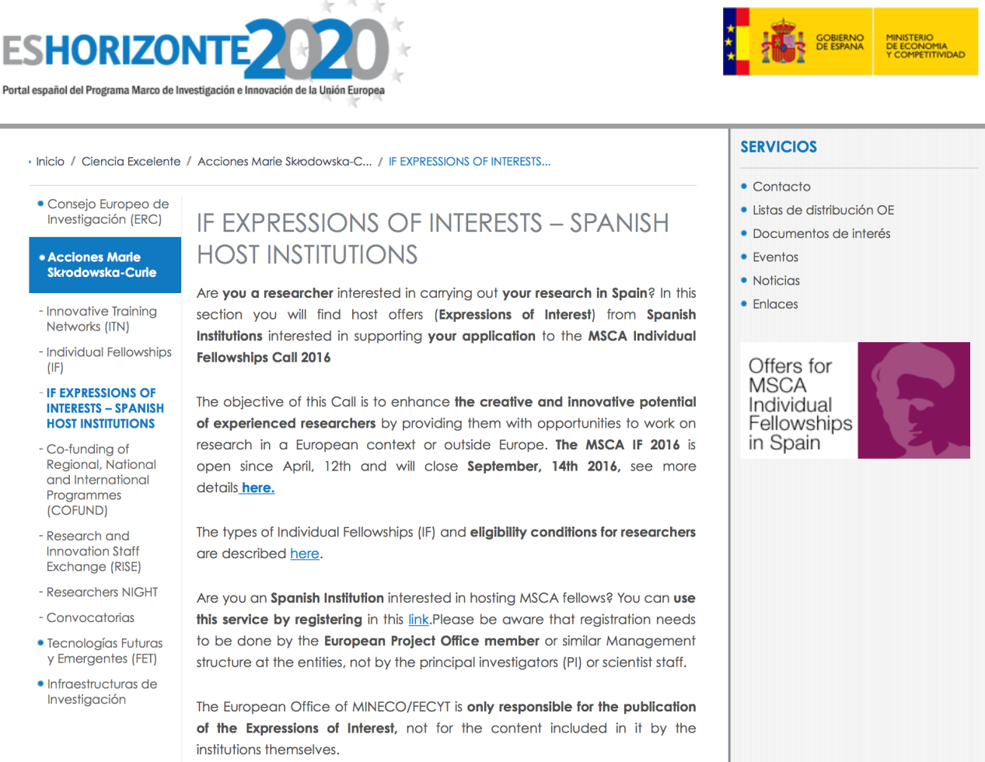
Looking for a MSCA in Spain?
Target:
For Hosting Organizations
For Fellows
http://www.eshorizonte2020.es/ciencia-excelente/acciones-marie-sklodowska-curie/if-expressions-of-interests-spanish-host-institutions

Slide 90
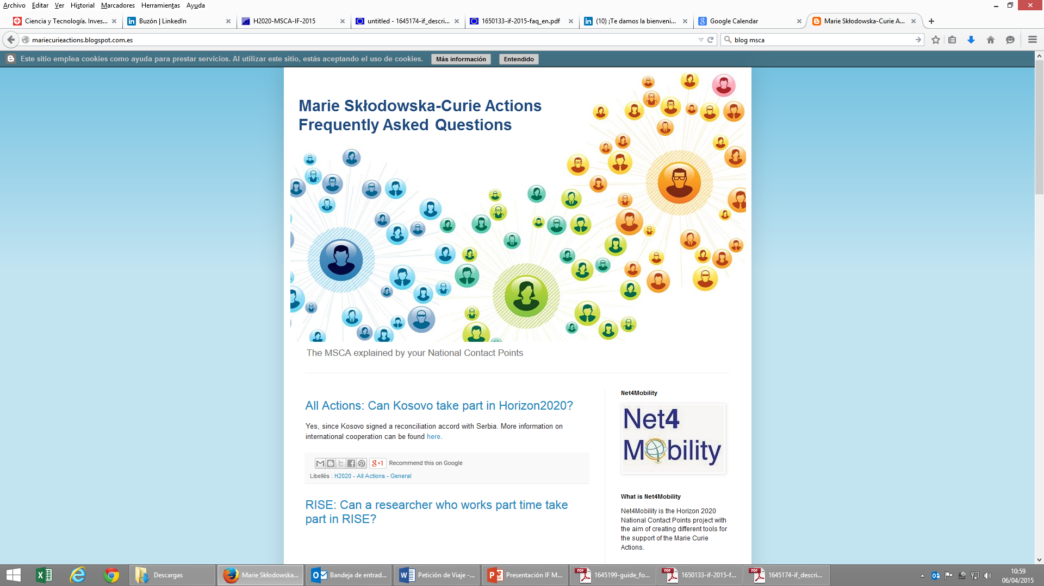
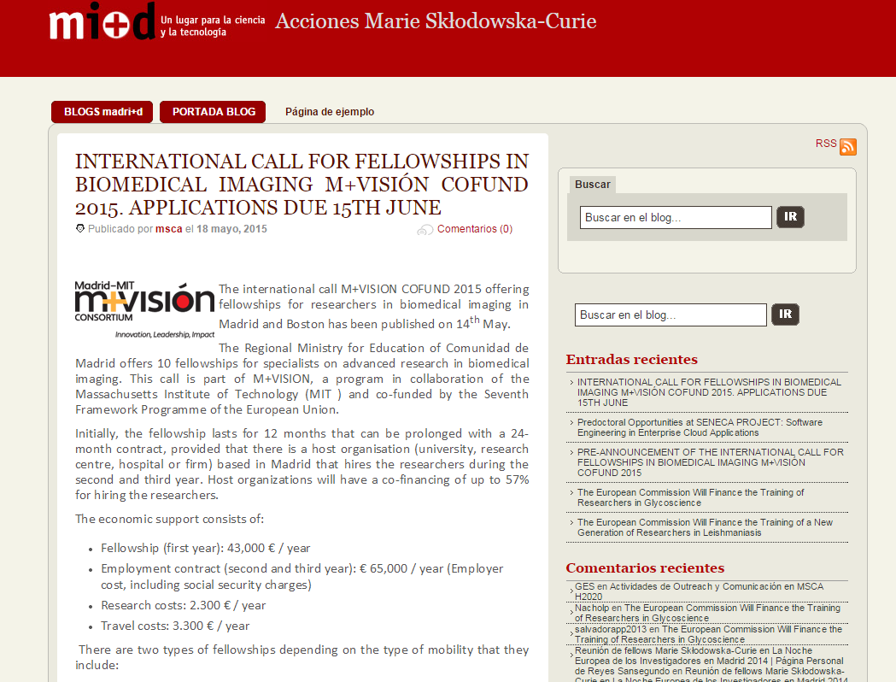
BLOG MSCA madri+d
BLOG MSCA NCPs
NCPs initiative since FP7
Q & A: FP7 People / MSCA / Management, preparation of proposals, etc…. complements the Participant´s Portal
MSCA Projects, results, publications…
8.400 users / 64.000 suscriptors Notiweb madri+d
www.madrimasd.org/blogs/msca
http://mariecurieactions.blogspot.com

Slide 91
MCA certificate: for FP7 researchers
Start long time ago – FP5
Requested by researchers
Tool set-up by REA in September 2015
Launched on 1 October 2015
Almost 9 000 requests received

Slide 92
How it works:
Certificate is not compulsory, it is a service offered to researchers
Certificate to be request by
    project contact person
    or the legal entity authorised representative (LEAR)
    or the scientist in charge
    at the coordinating institution
Information in the request must match 100% with REA database
In case of no match, info is checked manually
Functional mailboxes as a help for applicants

Slide 93
How it works:
Certificate can be requested for any researcher that was recruited/seconded in FP7 MCA project (ITN, IAPP, IRSES, COFUND, IEF, IOF, IIF, CIG, ERG, IRG)
Normally to be requested when the fellowship is already finalized (exceptions to be decided by the Coordinating institution)
Duration is not mentioned in the Certificate (e.g. to avoid incorrect data in case of split stays, etc.)

Slide 94
Support from REA:
"For additional information e-mail the functional mailbox of the relevant funding scheme. Please include the project number and attach any error message you might have got."
IEF - REA-MCAFP7-IEF@ec.europa.eu
IIF - REA-MCAFP7-IIF@ec.europa.eu
IOF - REA-MCAFP7-IOF@ec.europa.eu
ERG, IRG - REA-MARIECURIE-RG@ec.europa.eu
CIG - REA-MARIECURIE-CIG@ec.europa.eu
IRSES - REA-MCAFP7-IRSES@ec.europa.eu
COFUND - REA-MCAFP7-COFUND@ec.europa.eu
IAPP, ITN - REA-HOST-DRIVEN-ACTIONS@ec.europa.eu

Slide 95
Certificate online link: http://ec.europa.eu/rea/secure/mc_certificates_en.htm
Only for FP7 projects/researchers
Development for H2020 Certificate will start soon

Slide 96


Muchas gracias
NATIONAL CONTACT POINTS (NCP)
MARIE SKLODOWSKA-CURIE ACTIONS
Cristina Gómez
Oficina Europea FECYT / MINECO
cristina.gomez@oficinaeuropea.es
Tel: 91 603 79 56
Jesús Rojo
Fundación para el Conocimiento madri+d
jesus.rojo@madrimasd.org
Tel: 91 781 65 72

